Slide 1
HW6
20190312 신소재공학과 김서현

Slide 2
Formulas_Trapezoidal & Romberg Integral

Slide 3
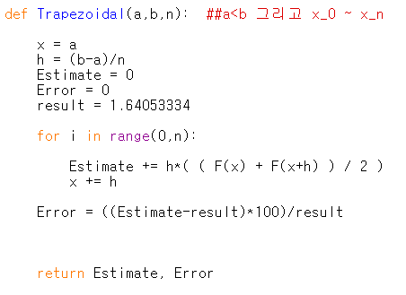
Trapezoidal

Slide 4
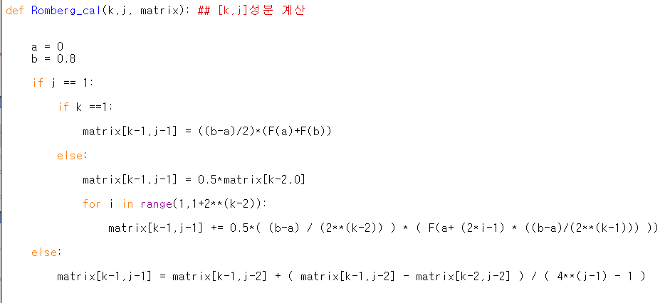
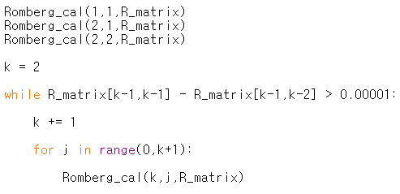
Romberg Integral

